Slide 1
Information Visualization

Slide 2
Outline
Introduction
Overview
Visualization Classification
A Framework for Information Visualization
Emerging Information Visualization Applications
Evaluation Research for Information Visualization
Summary and Future Directions

Slide 3
Introduction
Collecting information is no longer a problem, but extracting value from information collections has become progressively more difficult.
Visualization links the human eye and computer, helping to identify patterns and to extract insights from large amounts of information
Visualization technology shows considerable promise from increasing the value of large-scales collections of information

Slide 4
Introduction
Visualization has been used to communicate ideas, to monitor trends implicit in data, and to explore large volumes of data from hypothesis generation.
Visualization can be classified as scientific visualization, software visualization, and information visualization.
This chapter reviews information visualization techniques developed over the last decade and examines how they have been applied in different domains.

Slide 5
Outline
Introduction
Overview
Visualization Classification
A Framework for Information Visualization
Emerging Information Visualization Applications
Evaluation Research for Information Visualization
Summary and Future Directions

Slide 6
Overview of Visualization
Although visualization is a relatively new research area, visualization has a long history
First known map: 12th century (Tegarden,1999)
Multidimensional representations appeared in 19th century (Tufte, 1983)
In scientific fields
Bertin (1967) identified basic elements of diagrams in 1967
Most early visualization research focused on statistical graphs (Card et al., 1999)
Data explosion in 1980s (Nielson, 1991)
NSF launched the “Scientific visualization” initiative in 1985
IEEE 1st visualization conference in 1990

Slide 7
Overview of Visualization
In nonscientific contexts
“information visualization” was first used in Robertson et al. (1989)
Early information visualization systems emphasized
interactivity and animation (Robertson et al., 1993)
Interfaces to support dynamic queries (Shneiderman, 1994)
Layout algorithms (Lamping et al., 1995)
Later visualization systems emphasized
Subject hierarchy of the Internet (H. Chen et al., 1998)
Summarizing the contents of a document (Hearst, 1995)
Describing online behaviors (Donath, 2002; Zhun & Chen, 2001)
Displaying website usage patterns (Erick, 2001)
Visualizing the structures of a knowledge domain (C. Chen & Paul , 2001)
Information also needs the support of information analysis algorithms (H. Chen et al., 1998)
The lack of thorough, summative approaches to evaluating existing visualization systems has become increasingly apparent ( C. Chen & Czerwinskim, 2000)

Slide 8
Overview of Visualization
A Theoretical Foundation for Visualization
Human eye can process many visual cues simultaneously (Ware, 2000)
People have a remarkable ability to recall pictorial images (Standing et al., 1970)
Visual aids people to find patterns
But Patterns will be invisible if they are not presented in certain ways
Understanding visual perception can be helpful in the design of visualization system

Slide 9
A Theoretical Foundation for Visualization
Different parts of human memory can be enhanced by visualization in different ways (Ware, 2000)
Iconic memory is the memory buffer where pre-attentive processing operates
Certain visual patterns can be detected at this stage without having to go through the cognition process
Visual processing channel theory (Ware, 2000)
Design effective visualizations reply on understanding the perception of patterns
Working memory integrates information from iconic memory and long-term memory for problem solving
Patterns perceived by pre-attentive processing are mapped into patterns of the information space
Visualization can serve as an external memory, saving space in the working memory.
Long-term memory stores information in a network of linked concepts (Collins & Loftus 1975, Yufik & Sheridan 1996)
Using proximity to represent relationships among concepts in constructing a concept map has a long history
Visualization also use proximity to indicate semantic relationships among concepts

Slide 10
Outline
Introduction
Overview
Visualization Classification
A Framework for Information Visualization
Emerging Information Visualization Applications
Evaluation Research for Information Visualization
Summary and Future Directions

Slide 11
Visualization Classification
Scientific Visualization
Scientific visualization helps understanding physical phenomena in data (Nielson, 1991)
Mathematical model plays an essential role
Isosurfaces, volume rendering, and glyphs are commonly used techniques
Isosurfaces depict the distribution of certain attributes
Volume rendering allows views to see the entire volume of 3-D data in a single image (Nielson, 1991)
Glyphs provides a way to display multiple attributes through combinations of various visual cues (Chernoff, 1973)

Slide 12
Visualization Classification
Software Visualization and Information Visualization
Software visualization helps people understand and use computer software effectively (Stasko et al. 1998)
Program visualization helps programmers manage complex software (Baecker & Price, 1998)
Visualizing the source code (Baecer & Marcus, 1990) data structure, and the changes made to the software (Erick et al., 1992)
Algorithm animation is used to motivate and support the learning of computational algorithms
Information visualization helps users identify patterns, correlations, or clusters
Structured information
Graphical representation to reveal patterns. e.g. Spotfire, SAS/GRAPH, SPSS
Integration with various data mining techniques (Thealing et al., 2002; Johnston, 2002)
Unstructured Information
Need to identify variables and construct visualizable structures. e.g. antage Point, SemioMap, and Knowledgist

Slide 13
Outline
Introduction
Overview
Visualization Classification
A Framework for Information Visualization
Emerging Information Visualization Applications
Evaluation Research for Information Visualization
Summary and Future Directions

Slide 14
A Framework for Information Visualization
Research on taxonomies of visualization
Chuah and Roth (1996) listed the tasks of information visualization
Bertin (1967) and Mackinlay (1986) described the characteristics of basic visual variables and their applications.
Card and Mackinlay (1997) constructed a data type-based taxonomy.
Chi (2000) proposed a taxonomy based on technologies.
Four stages: value, analytic abstraction, visual abstraction, and view
Shnederman (1996) identified two aspects of visualization: representation and user-interface interface
C.Chen (1999) indicated that information analysis also helps support a visualization system
Three research dimensions support the development of an information visualization system
Information representation
User interface interaction
Information analysis

Slide 15
Information Representation
Shneiderman (1996) proposed seven types of representation methods:
1-D
2-D
3-D
Multidimensional
Tree
Network
Temporal approaches

Slide 16
1-D
To represent information as one-dimensional visual objects in a linear (Eick et al., 1992; Hearst, 1995) or a circular (Salton et al.,1995) manner.
To display contents of a single document (Hearst, 1995; Salton et al., 1995)
To provide an overview a a document collection (Eick et al., 1992)
Colors usually represent some attributes, e.g. SeeSoft system(Eick et al., 1992) and TileBars (Hearst, 1995).
A second axis may also play a role.

Slide 17
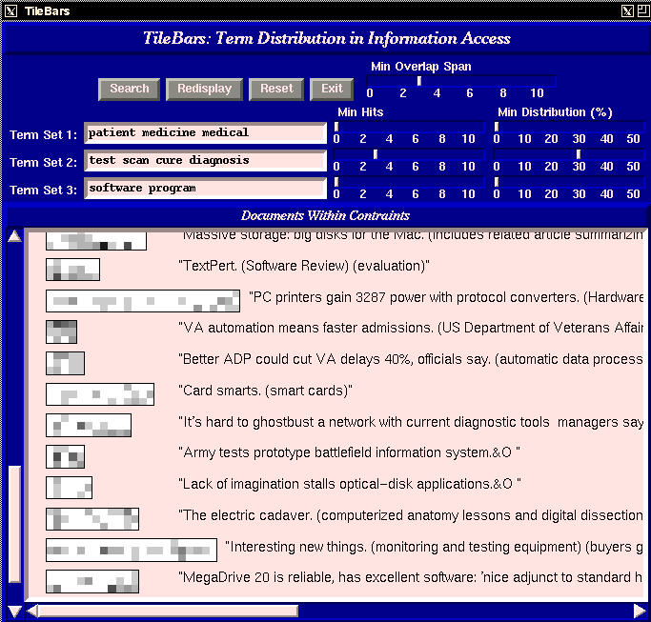
1-D
TileBars (Hearst, 1995)

Slide 18
2-D
To represent information as two-dimensional visual objects
Visualization systems based on self-organizing map (SOM) (Kohonen, 1995)
To help uses deal with the large number of categories created for the mass textual data

Slide 19
3-D
To represent information as three-dimensional visual objects
WebBook system folds web pages into three-dimensional books (Card et al., 1996)
3-D version of a tree or network
3-D hyperbolic tree to visualize large-scale hierarchical relationships (Munzner 2000)

Slide 20
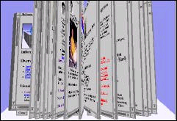
3-D
WebBook (Card et al., 1996)

Slide 21
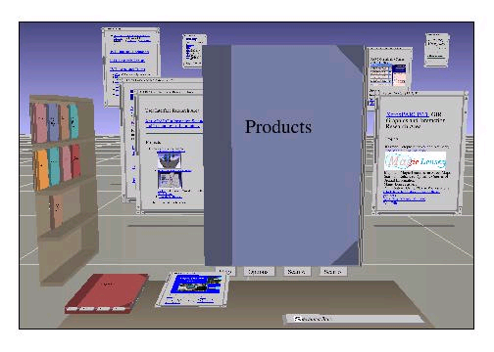
3-D
WebForager (Card et al., 1996)

Slide 22
Multidimensional
To represent information as multidimensional objects and projects them into a three-dimensional or a two-dimensional space
Dimensionality reduction algorithm will be used
Multidimensional scaling (MDS)
Hierarchical clustering
K-means algorithms
Principle components analysis
Examples
SPIRE system (Wise et al. 1995)
VxInsight System (Boyack et al. 2002)
Glyph representation has been used in various social visualization techniques (Donath, 2002) to describe human behavior during computer-mediated communication (CMC)

Slide 23
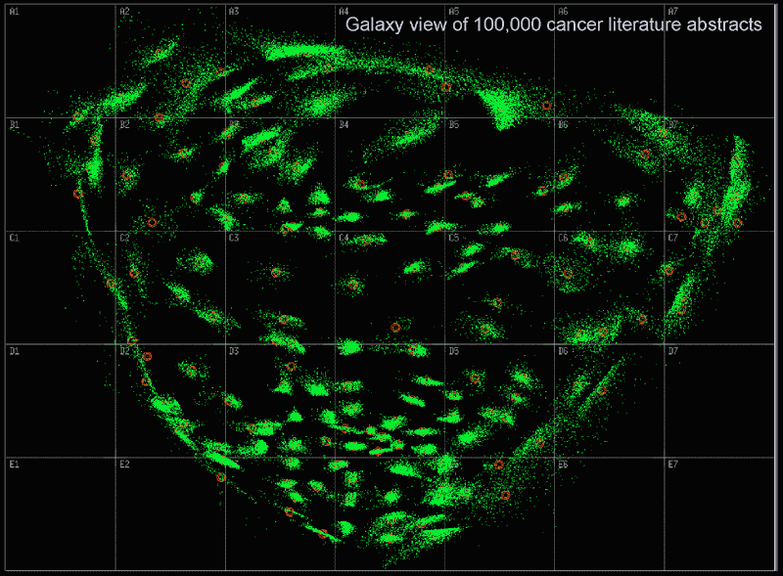
Multidimensional
SPIRE (Wise et al., 1995)

Slide 24
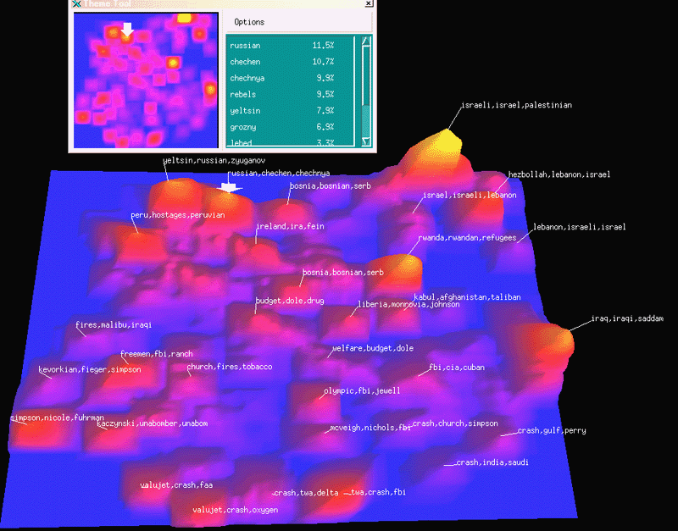
Multidimensional
SPIRE (Wise et al., 1995)

Slide 25
Tree
To represent hierarchical relationship
Challenge: nodes grows exponentially
Different layout algorithms have been applied
Examples
Tree-Map allocates space according to attributes of nodes (Johnson & Shneiderman 1991)
Cone Tree system uses e-D visual structure to pack more nodes on the screen (Robertson et al., 1991)
Hyperbolic Tree projects subtrees on a hyperbolic plane and puts the plane (Lamping et al., 1995)

Slide 26
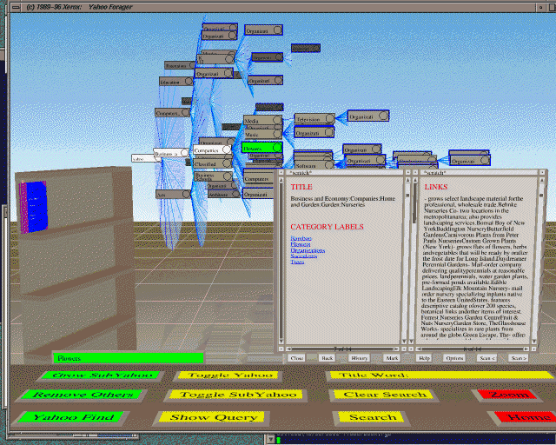
Tree
Cat-a-Con Tree(Hearst & Karadi, 1997)

Slide 27
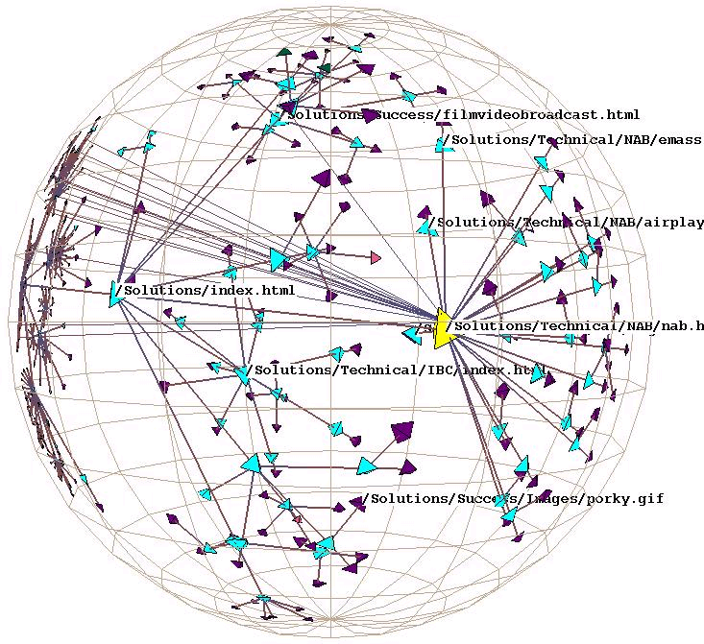
Tree
3-D hyberbolic space (Munzner, 2000)

Slide 28
Network
To represent complex relationships that a simple tree structure is insufficient to represent
Citation among academic papers( C. Chen & Paul 2001; Mackinlay et al., 1995)
Documents linked by the internet (Andrews, 1995)
Spring-embedder model (Eades, 1984) along with its variants ( Davidson & Harel, 1996;l Fruchterman & Reingold, 1991) have become the most popular drawing algorithms.

Slide 29
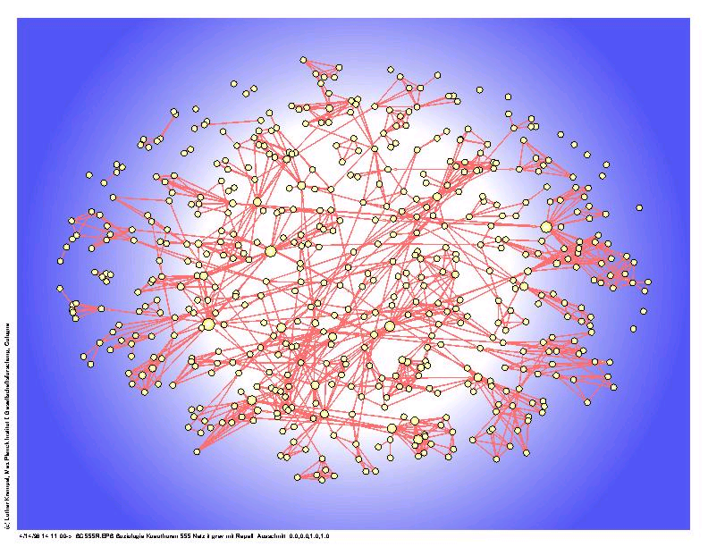
Network
Co-authorship network (Lothar Krempel)

Slide 30
Temporal
To represent information based on temporal order
Location and animation are commonly used visual variables to reveal the temporal aspect of information
Examples
Perspective Wall lists objects along the x-axis based on time sequence and presents attriibutes along the y-axis (Robertson et al., 1993)
In VxInsight system (Boyack et al., 2002), the landscape changes as the time changes.

Slide 31
Information Representation
A visualization system usually applies several methods at the same time
Some representation methods also need to have a precise information analysis technique at the back end
The “small screen problem” (Robertson et al., 1993) is common to representation methods of any type.
Integrated with user-interface interaction

Slide 32
A Framework for Information Visualization
User-Interface Interaction
Immediate interaction not only allows direct manipulation of the visual objects displayed but also allows users to select what to be displayed (Card et al., 1999)
Shneiderman (1996) summarizes six types of interface functionality
Overview
Zoom
Filtering
Details on demand
Relate
history

Slide 33
A Framework for Information Visualization
User-Interface Interaction
Two most commonly used interaction approaches:
Overview + detail
First overview provides overall patterns to users; then details about the part of interest to the use can be displayed. (Card et al., 1999)
Spatial zooming & semantic zooming are usually used
Focus + context
Details (focus) and overview (context) dynamically on the same view. Users could change the region of focus dynamically.
Information Landscape( Andrews, 1995)
Cone Tree (Robertson et al., 1991)
Fish-eye (Furnas, 1986)

Slide 34
A Framework for Information Visualization
Information Analysis
To reduce complexity and to extract salient structure
Two stages of information analysis
Indexing
Analysis

Slide 35
A Framework for Information Visualization
Two stages of information analysis
Indexing
Extract the semantics of information
Automatic indexing(Salton,1989) represents the content of each document as a vector of key terms
Natural language processing noun-phrasing technique can capture a rich linguistic representation of document content (Anick & Vaithyanathan, 1997)
Most noun phrasing techniques rely on a combination of part-of-speech-tagging (POST) and grammatical phrase-forming rules
MIT Chopper Nptool (Coutilainen, 1997)
Arizona Noun Phraser (Tolle & Chen 2000)
Information extraction extracts entities from textual documents
Most information extraction approaches combine machine learning and a rule-based or a statistical approach
System that extracting entities from New York Times (Chinchor, 1998)

Slide 36
A Framework for Information Visualization
Two stages of information analysis
Analysis
Classification
Bayesian method (Koller & Sahami, 1997; Lewis& Ringuette, 1994; etc)
K-nearest neighbor (Iwayama & Tokunaga, 1995; Masand et al., 1992)
Network models (Lam & Lee, 1999; Ng et al., 1997; Wiener, 1995)
Clustering
Self-organizing map (Kohonen, 1995; Lin et al., 1991; Orwig et al., 1997)
Multidimensional scaling
K-nearest neighbor
Ward’s algorithm (Ward, 1963)
K-means algorithm

Slide 37
Outline
Introduction
Overview
Visualization Classification
A Framework for Information Visualization
Emerging Information Visualization Applications
Evaluation Research for Information Visualization
Summary and Future Directions

Slide 38
Emerging Information visualization Apps.
Digital Library Visualization
Browsing
Searching
Web Visualization
Visualization of a single website
Visualization of a collection of websites
Virtual Community Visualization
Tools for communication management
Tools for community analysis

Slide 39
Digital Library Visualization
Browsing a Digital Library
To retrieve information when a user does not have a specific goal (H. Chen et al., 1998)
Visualization supports browsing by providing an effective overview that summarizes the contents of a collection.
Browse by subject hierarchy
MEDLINE: MeSH tree structure (Lowe & Barnett, 1994)
MeSHBROWSE system enables users to browse a subset of MeSH tree interactively (Korn& Shneiderman, 1995)
Hearst and Karadi (1997) proposed using a three-dimensional Cone Tree and animation to display the MeSH tree.
CancerMap system adopted the SOM and Arizona Noun Phraser to generate a subject hierarchy automatically (Chen et al, 2003)
Browse by geographical locations (Cai, 2002)

Slide 40
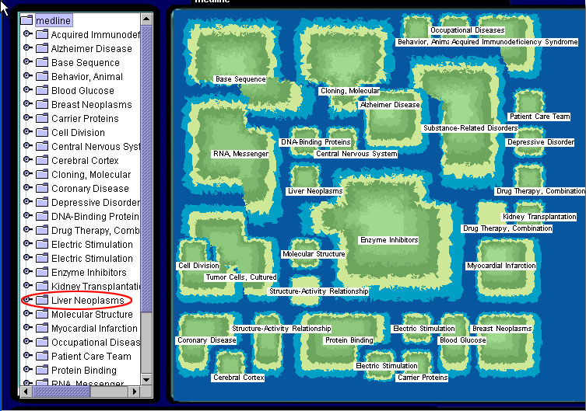
Browsing a Digital Library
CancerMap (Chen et al, 2003)

Slide 41
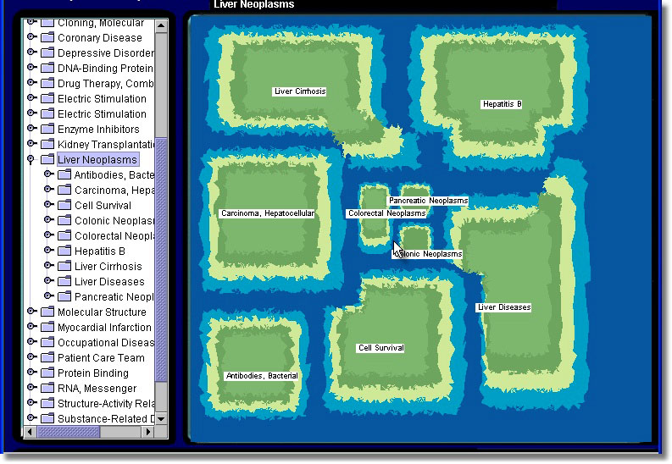
Browsing a Digital Library
CancerMap (Chen et al, 2003)

Slide 42
Digital Library Visualization
Searching a Digital Library
Visualization can support searching behavior in two ways:
Query specification
Providing a subject hierarchy could suggest appropriate query terms
Search result analysis
To use dynamic SOM to categorize search results (Chen, 2002)
VIBE (Olsen et al, 1993) and TileBars (Hearst, 1995) provide visual cues to indicate the extent of match between a document returned and a query term.

Slide 43
Web Visualization
Visualization of a single website
Hyperbolic tree
StarTree by InXight Software
SiteBrain by brain Technologies Corporation
Z-factor site map by Dynamic Diagrams
(Eric 2001) describes several hyperbolic tree + fish-eye systems
(Chi et al 1998) used Cone Tree to depict the temporal evolution of a website
Challenge: How can a very large-scale tree be displayed on a computer screen in an understandable way

Slide 44
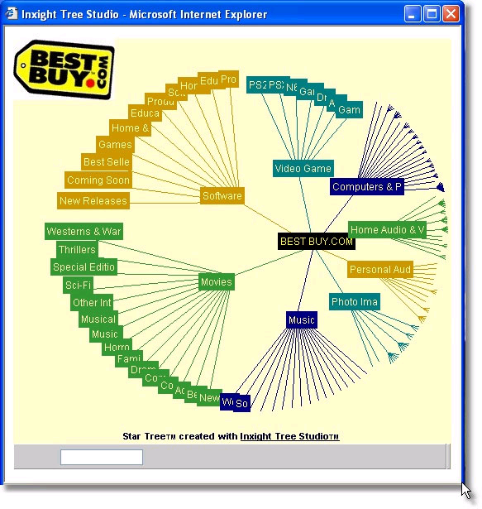
Visualization of a single Website
StarTree (by InXight

Slide 45
Web Visualization
Visualization for a collection of websites
To support information exploration over the internet
Some systems organize web pages based on content
ET map used automatic indexing to represent the content and SOM to generate the subject hierarchy (H. Chen et al., 1998)
Some systems organize web pages based on link structure
Bray (1996)calculated links among websites to measure the “visibility” and the “luminosity” of each website

Slide 46
Web Visualization
Virtual Community Visualization
Tools for communication management
ContactMap likes a visual address book with all contacts as icons ( Whittaker et al, 2002)
Chat Circles represents users as circles (Donath et al., 1999)
Tools for community analysis
Loom uses 2-D representation to describe the temporal patterns of postings in Usenet (Donath et al., 1999)
Conversation Map depicts a community by displaying its social and semantic relationships using the network (Sack, 2000)
Netscan Dashboard (Microsoft) employs e-D tree to display the hierarchical structure of a thread.
Netscan Treemap (Microsoft) uses Treemap (Shneiderman, 1994) to present hierarchical relationships among Usenet news groups
Communication Garden combines a floral representation with SOM to describe the liveliness of subtopic and to locate the most active persons.

Slide 47
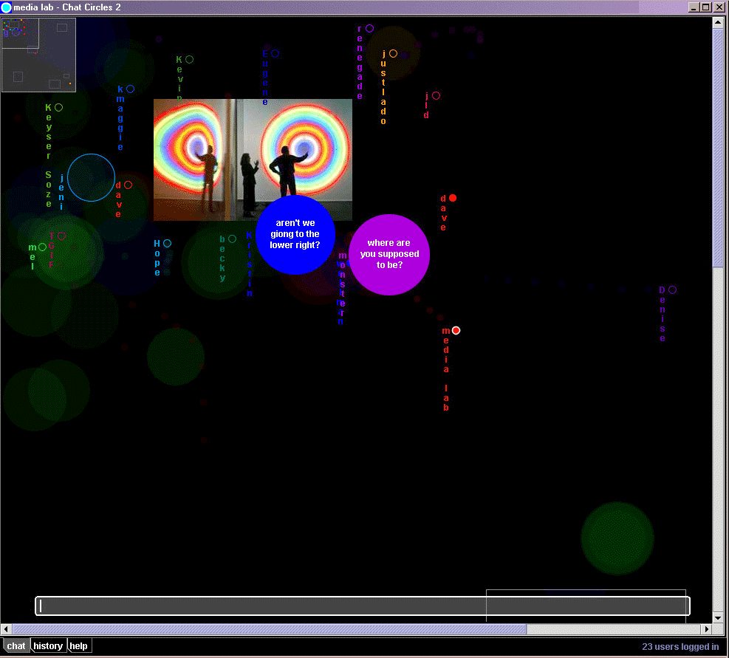
Tools for communication management
Chat Circles 2 (Donath et al, 1999)

Slide 48
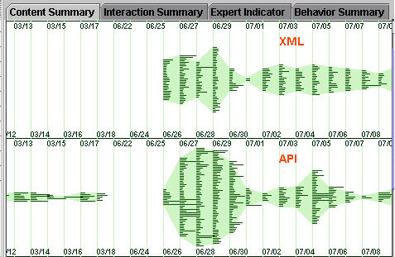
Tool for community analysis
Communication Garden- Content Summary

Slide 49
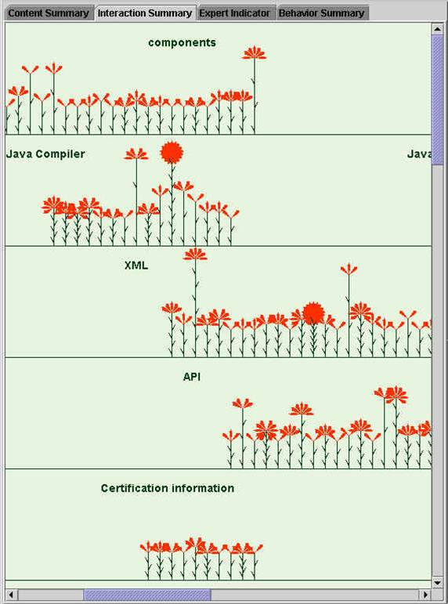
Tool for community analysis
Communication Garden- Interaction Summary

Slide 50
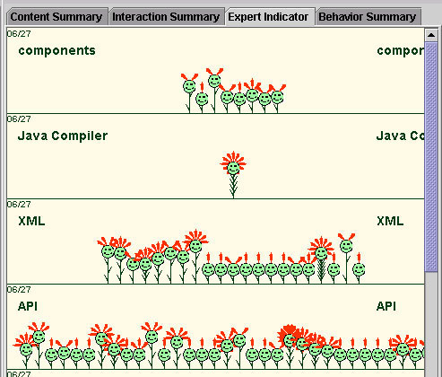
Tool for community analysis
Communication Garden- Expert Indicator

Slide 51
Outline
Introduction
Overview
Visualization Classification
A Framework for Information Visualization
Emerging Information Visualization Applications
Evaluation Research for Information Visualization
Summary and Future Directions

Slide 52
Evaluation Research of Information Visualization
Empirical usability studies
To understand the pros and cons of specific visualization designs or systems
Laboratory experiments approach
Comparing a glyph-based interface and a text based interface (Zhu & Chen 2001)
Comparing different visualization techniques (Stasko et al., 2000)
De-featuring approach
Several studies have been conducted to evaluate popular tree representations, such as Hyperbolic Tree (Pirolli et al., 2000), Treemap (Stasko et al., 2000), and multilevel SOM (Ong et al., in press)
Complex, realistic, task-driven evaluation studies have been conducted frequently, e.g. (Pohl & Purgathofer, 2000; Risden et al., 2000; North and Shneiderman, 2000). They could measure usefulness. But it is difficult to identify each visualization factors’ contribution.
Behavioral methods also need to be considered

Slide 53
Evaluation Research of Information Visualization
Fundamental perception studies and theory building
To investigate basic perceptual effects of certain visualization factors or stimuli
Theories from psychology and neuroscience are used to understand the perceptual impact of visualization parameters as animation (Bederson & Boltman, 1999), information density (Pirolli et al., 2000), 3-D effect (Tavanti & Lind, 2001)and combinations of visual cues (Nowell et al., 2002)
It usually involves some form of computer-based visualization
Bederson and Boltman (1999) used the Pad++ to study the impact of animation of users’ learning of hierarchical relationships
Pirolli et al. (2000) used a hyperbolic tree with fish0eye view to study the effect of information density.
Results may be applied only to the particular visualization system understudy

Slide 54
Outline
Introduction
Overview
Visualization Classification
A Framework for Information Visualization
Emerging Information Visualization Applications
Evaluation Research for Information Visualization
Summary and Future Directions

Slide 55
Summary and Future Directions
This chapter reviewed information visualization research based on a framework of information representation, user0interafact interaction, and information analysis
Although this chapter focuses on the visualization of textual information, many associated techniques can be applied to multimedia visualization.
Information visualization can help people gain insights from large-scale collections of unstructured information

Slide 56
Summary and Future Directions
Future Directions
Visual Data Mining
To identify patterns that a data mining algorithm might find difficult to locate
To support interaction between users and data
To support interaction with the analytical process and out put of a data mining system
Virtual Reality-Based Visualization
To take advantage of the entire range of human perceptions, including auditory and tactile sensations
Visualization for Knowledge Management
To facilitate knowledge sharing and knowledge creation
To accelerate internalization by presenting information in an appropriate format or structure or by helping users find, relate, and consolidate information and thus helping to form knowledge. (C. Chen & Paul, 2001; Cohen, Maglio & Barrett, 1998; Foner, 1997; Vivacqua,1999)
From “information visualization” to “knowledge visualization”

